Slide 1
Lesson Overview
In previous lessons, we have described the evolution of incidents from routine operations through major events. We have also described the resource ordering process from the incident to the Emergency Operations Center and the Multiagency Coordination Group, and the flow of information that ensures resource accountability is present at all levels. In this lesson, we will expand that discussion to include the issues related to managing complex incidents.

Slide 2
Unit 5 Objectives
At the end of this lesson, you should be able to:
  Describe the ordering procedures and configuration and logistical support needs for State mobilizations and Federal resources.
  Identify issues concerning the mobilization of large quantities of resources and the prioritization systems for identifying and assigning scarce resources.
  Describe the complications with and strategies for managing donations and spontaneous volunteers.

Slide 3

What are the characteristics of complex incidents?

Slide 4
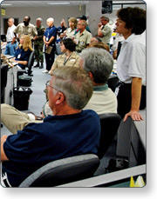
Coordinating Resources
The process for coordinating resources for complex incidents dovetails with that used for individual, smaller incidents. However, in complex incidents there are numerous Multiagency Coordination elements involved in resource coordination including:
  Local, State, and Federal Emergency Operations Centers (EOCs)
  MAC Groups
  FEMA Regional Response Coordination Centers
  Joint Field Offices (JFOs)
  National Response Framework agencies
  Department of Homeland Security
It must be remembered that the authority and structure of EOCs, MAC Groups, etc., varies from agency to agency and jurisdiction to jurisdiction. However, it is important also to remember the difference between command and coordination.

Slide 5
Command and Coordination
The Incident Management Team (IMT) has authority for command of the incident. This authority is delegated directly from the Agency Administrator. The Incident Management Team determines incident objectives and tactics, and assigns resources to carry them out. The MAC System is responsible for coordinating support to the incident(s). This may include prioritizing incidents for the purpose of allocating scarce resources, mobilizing resources, ensuring interagency and interjurisdictional coordination, and making policy decisions to support incidents, but not decisions reserved for Area Commands and Incident Commanders.

Slide 6

Coordinating Resource Needs: Step 1
The first step in coordinating resource needs is a thorough assessment or "sizeup" of the current incident situation and future incident potential. The scope and details of this assessment depend on the jurisdictional level of the organization. For example, a County EOC must have a detailed understanding of the status of all jurisdictions and current incidents within its purview, plus a good understanding of the status of surrounding counties. The EOC should also maintain a general awareness of national conditions, especially for situations that may affect resource availability.

Slide 7
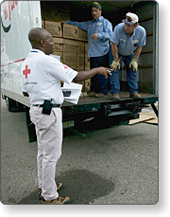
Coordinating Resource Needs: Step 2
The Incident Commander develops incident objectives. For the supporting coordination entities, these objectives may translate into requests for additional resources. One of the characteristics of complex incidents is that there may be competition for limited critical resources.
In order to allocate resources appropriately, the Emergency Operations Center and the MAC Group must be able to prioritize multiple incidents happening simultaneously.
MAC Groups are primarily responsible for resource prioritization and allocation. Unlike Unified Command, they do not perform incident command functions, nor do they replace the primary functions of operations, coordination, or dispatch organizations. When competition for resources is significant, MAC Groups may relieve the coordination and dispatch organizations of some prioritization and allocation responsibilities.
Life safety is the priority when making resource allocation decisions.

Slide 8

Activity: Prioritization Considerations
Instructions: Working with your table group . . .
  Review the scenario below.
  Prioritize the incidents in your jurisdiction, based on the overall priorities of life safety, incident stabilization, and property/environmental conservation.
  Write your answers on chart paper.
  Select a spokesperson and be prepared to present in 10 minutes.
  Be prepared to explain your group's reasoning.
Scenario and Incidents:
The hurricane passed directly over your jurisdiction. There are several major incidents underway. Many of the Incident Commanders are calling for additional law enforcement officers to secure affected areas. Multiple incidents have hazardous materials issues, and there is only one hazmat team available. Power is still out in most of your jurisdiction, and there is also a shortage of ice and potable water.
Assisted-Living Incident: An assisted-living center has collapsed. Four elderly residents remain trapped. Response has been hampered by the well-meaning but dangerous and ineffective help from residents of the neighborhood. Power lines are down in the area, and it is not clear whether any of them are hot. The Incident Commander has requested additional law enforcement and the Fire Department's Technical Rescue Task Force.
Chemical Incident: Apex Chemical Company is a major employer in the city. Support for their chemical holding tanks was eroded by flooding which accompanied the storm. One tank is leaking into its containment pond, which is already full of storm water. If the containment pond overflows, the excess will run into the creek. The chemical is very toxic, and can persist in the environment for years. If the chemical escapes containment, plants and wildlife in the area will be killed, and the creek bed will suffer long-term contamination. The company has pumps to drain the containment pond, but no generator to run them. They are requesting a generator, and the assistance of the local hazardous materials response team.
Storm Surge Incident: The storm surge has washed away access to an exclusive beach-front community. Power, water, and sewer service are out here, and residents are concerned about security for the community. The sewage system has been damaged at a major service junction, and although there has been no sewage spill, service cannot be restored until it is fixed. Repair will require a technical confined-space operation. Only the local hazardous materials response team is qualified to conduct a confined-space operation. Residents have been trying to convince the Incident Commander to allow them back into their houses. She has so far refused, but has promised to increase security while the utility companies attempt to restore service. The Incident Commander has requested additional law enforcement, and the local hazardous materials response team.

Slide 9
Coordinating Resource Needs: Steps 3 and 4
Step 3:
Allocate scarce resources according to priority.
Step 4:
Determine additional steps that need to be taken. These additional steps could include mission-tasking other organizations for resources, making policy decisions to assist in the response, allocating donated goods and services, etc. For example, in the activity just completed, there may be ways to accomplish the security and traffic control needs at the assisted-living center without assigning sworn police officers. Many event management companies have employees experienced in crowd and traffic control and security.

Slide 10
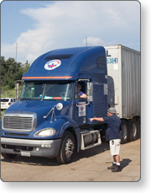
Mobilizing Resources (1 of 2)
During complex incidents, resource mobilization becomes complicated, as more agencies and levels of government become involved, more incidents require assistance, supply lines and response times get longer, and more resources mobilize. This increased workload is often underestimated.
Maintaining ordering discipline and the coordination chain will assist in avoiding duplication of effort, additional expense, and lost requests. However, it is important to remember that, in some complex incidents, State and Federal resources may take some time to arrive.
The next screen will provide an animated example of the process.

Slide 11
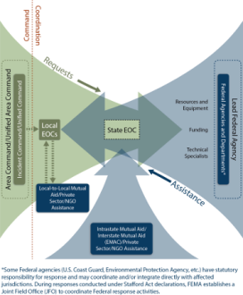
Mobilizing Resources (2 of 2)
This graphic depicts the flow of assistance during large-scale incidents.

Slide 12
Dealing With Convergence
Convergence is the result of unstructured response to an incident. Convergence can come from several sources, and may severely hamper incident response activities, as well as place an enormous logistical burden on an already burdened system. It may also provide unexpected benefits, especially in the period of time between the occurrence of the incident and the arrival of State and Federal resources.
Convergence issues may include any or all of the following:
  Local resources (requested resources, and also well-intentioned freelancing and unrequested, self-dispatched emergency responders)
  State and Federal agency resources (requested resources, as well as unrequested, self-dispatched resources from field offices close to the incident)
  Donations and volunteer assistance
  VIP visits

Slide 13
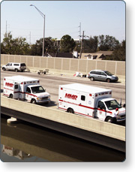
Emergency Responder Convergence (1 of 2)
Even under "normal" incident conditions, the incident scene can rapidly become clogged with apparatus, command staff vehicles, and bystanders. Such congestion:
  Causes unnecessary exposure to hazards (including incidents where responders may be the primary or secondary target).
  Makes access difficult for resources that are needed for the response.
  Complicates resource accountability and tracking.
During major events, this "normal" congestion can become aggravated by self-dispatched and freelancing emergency responders. Self-dispatched resources and freelancing cause serious problems.
Personnel should NOT respond to the scene unless requested and dispatched.

Slide 14
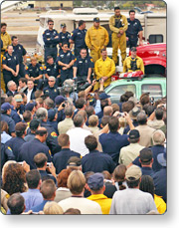
Emergency Responder Convergence (2 of 2)
In addition to creating the problems noted earlier, emergency responder convergence may:
  Deplete reserve resources that are needed to provide continued services to the community.
  Compromise service provided under mutual aid and assistance agreements and disrupt orderly backup/moveup coverage.
  Make it difficult to track resources or maintain resource accountability.
  Interfere with evacuation.
  Hamper access of formally requested resources.
  Increase the complexity of actions to protect responders from additional threats.

Slide 15
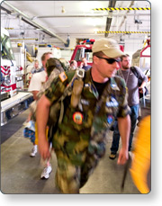
Strategies for Dealing With Emergency Responder Convergence (1 of 2)
Strategies for dealing with responder convergence include:
  Developing a local and regional capability to augment and sustain a reinforced response for at least 72 hours. This capability should be accompanied by policies governing self-dispatch and freelancing. Self-dispatch may be unavoidable—managing unrequested resources should be anticipated and planned for.
  Developing a plan for continued public safety service. This plan should include an organized policy and procedure for the orderly recall of additional personnel, as well as a policy to define the deployment of personnel to assist other agencies in times of crisis. Don't forget to include backup for EOC personnel as well as emergency responders and ICS staff.

Slide 16
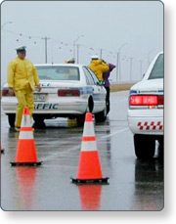
Strategies for Dealing With Emergency Responder Convergence (2 of 2)
Additional strategies include:
  Establishing and enforcing inner and outer perimeters. Exclude freelancing or self-dispatched resources as well as unauthorized civilian or volunteer access.
  Establishing and enforcing a controlled access plan for authorized personnel. This may require immediate access to large quantities of fencing materials.
  Developing, establishing, and enforcing a coordinated traffic management and evacuation plan.
  Establishing and enforcing Staging Areas.

Slide 17

Lessons Learned: Emergency Responder Convergence
The events of 9/11 taught the New York City Fire Department many important lessons about dealing with emergency responder convergence.
All three jurisdictions responding to the 9/11 attacks faced freelancing emergency responders from the home agency and from nearby mutual aid cooperators. As a result of this, the New York Fire Department implemented the following policies:
  Only on-duty members shall respond to alarms on apparatus.
  Persons other than members of the New York Fire Department are to be excluded from the response. This includes former members of the department, members of other fire departments, friends, and relatives.
  Members who have arrived at incidents prior to responding companies, and those whose assistance has been accepted by authorized Fire Officers, are subject to the direction and control of the Incident Commander. It is the policy of the department that such members are relieved as soon as sufficient on-duty, properly equipped and protected resources have arrived. The Incident Commander's authority in this matter is absolute.
  In response to recall, members shall report to their assigned quarters. They shall not respond directly to the incident.

Slide 18
If a large scale, complex disaster such as an earthquake occurred in your jurisdiction, what are some potential convergence issues you would need to prepare for?

Slide 19
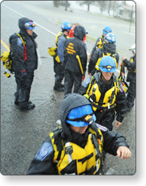
State and National Mobilizations
While interstate Emergency Management Assistance Compacts (EMAC system) and the National Response Framework provide vital resources to overwhelmed jurisdictions, their arrival can cause additional convergence issues. Even resources such as Urban Search and Rescue (US&R) Task Forces, who come prepared to be self-sufficient for 72 hours, will need a secure location in which to store equipment, conduct planning, eat, and sleep. Other teams, such as a Disaster Mortuary Team (DMORT) or National Transportation Safety Board (NTSB) accident investigation teams, may need specific kinds of support from local government, including special facilities and utility needs, and security assistance.
In order to be able to deploy immediately, most Federal resources arrive with a full contingent of personnel, equipment, and supplies. A review of the components of the FEMA US&R Task Forces reveals how significant the amount of resources may be.

Slide 20
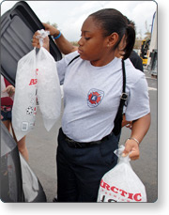
Strategies for State and Federal Deployments (1 of 3)
Strategies for managing State and Federal deployments include:
  Making sure that statewide mutual aid agreements include instructions on staging, standards for ensuring interoperability of equipment and communication, the expected degree of self-sufficiency, and the specific support expected from the host jurisdiction.
  Reviewing and assessing the support requirements of frequently deployed Federal resources.
  Developing a plan to integrate State and Federal assets into incident operations. Plan for the use of Unified Command and interdisciplinary tactical operations.
  Building relationships with State and Federal officials likely to respond to complex incidents by training and exercising together.
  Identifying locations suitable for remote Staging Areas, Incident Bases, Receiving and Distribution Centers, and Mobilization Centers.

Slide 21
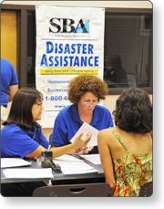
Strategies for State and Federal Deployments (2 of 3)
It is important to pre-identify facilities necessary to support State and Federal mobilizations.
  Facilities will be required for the incident itself, including the Incident Command Post, Staging Areas (run by Operations), and Incident Bases (managed by Logistics).
  Facilities are also needed "off-incident," such as Receiving and Distribution and Mobilization/Demobilization Centers, where resources are gathered, housed, and supported while awaiting specific incident assignments, and locations for Disaster Recovery Centers (DRCs), Joint Operations Centers (JOCs), and Joint Information Centers (JICs).

Slide 22
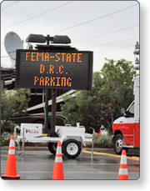
Strategies for State and Federal Deployments (3 of 3)
In addition to the facilities themselves, resource considerations should include:
  Security
  Parking
  Access
  Utilities
  Access to commercial sources of food, sanitation, lodging
  Janitorial and garbage service
Facilities to consider for use:
  Airports and heliports
  Aircraft hangars
  Warehouses
  Large parking lots
  Campgrounds
  Hotels, motels, and dormitories
  Office spaces
  Conference spaces

Slide 23
If a large scale, complex disaster such as an earthquake occurred in your jurisdiction, what are some potential convergence issues you would need to prepare for?

Slide 24
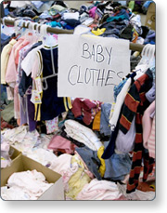
Donations and Volunteer Assistance (1 of 2)
It is difficult to overstate the monetary and psychological importance of donations and volunteer assistance during a major disaster. Successfully managing and tracking donations and coordinating the efforts of volunteers (solicited or unsolicited) can be a significant political, psychological, and logistical opportunity—and a problem.
Donations take the form of either funds, or donations of goods and services. The key to successful management of these assets is having a preincident plan for soliciting, gathering, prioritizing, and distributing appropriate donations.

Slide 25
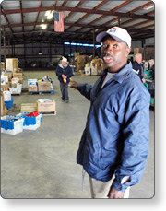
Donations and Volunteer Assistance (2 of 2)
The system must also be prepared to deal with inappropriate donations without bogging down the distribution of essential goods and services.
The inability to manage donations can lead to an "emergency within an emergency." It may even become necessary for the jurisdiction to protect itself from charges of mismanagement, or from being billed at a later date for goods and services presented as "donations" at the time.

Slide 26

Unaffiliated Volunteers
Unaffiliated volunteers, also known as spontaneous volunteers, are individuals who offer to help or self-deploy to assist in emergency situations without fully coordinating their activities. These volunteers are considered “unaffiliated” in that they are not part of a disaster relief organization.
Unaffiliated volunteers can be significant resources, but because they do not have preestablished relationships with emergency response organizations, verifying their training or credentials and matching them with the appropriate service areas can be difficult.
Access the National Response Framework Volunteer and Donations Management Support Annex at this website: https://www.fema.gov/pdf/emergency/nrf/nrf-support-vol.pdf

Slide 27

Strategies for Managing Volunteers (1 of 2)
The first strategy for managing volunteers is to establish working relationships with the local organizations representing these entities:
  National Voluntary Organizations Active in Disaster (National VOAD) is the forum where organizations share knowledge and resources throughout the disaster cycle—preparation, response, and recovery—to help disaster survivors and their communities. National VOAD members are the primary coordinating nonprofit organizations for the management of unaffiliated volunteers.
  Citizen Corps helps coordinate volunteer activities that will make our communities safer, stronger, and better prepared to respond to any emergency situation. It provides opportunities for people to participate in a range of measures to make their families, their homes, and their communities safer from the threats of crime, terrorism, and disasters of all kinds.

Slide 28
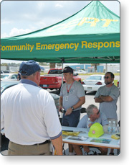
Strategies for Managing Volunteers (2 of 2)
Volunteers such as amateur radio operators, search and rescue teams, Community Emergency Response Team (CERTs), police and fire auxiliaries, and reserves are valued members of emergency management organizations in many jurisdictions.
Such resources are known quantities that train and exercise to play specific roles in an incident. These volunteers have long-standing formal relationships that are spelled out in written agreements and standard operating procedures. Individual members have credentials and identification issued by the volunteer organization itself and/or the emergency management organization with which it has the agreement.
Consider:
  Developing a CERT capability if your jurisdiction does not have one.
  Making sure agreements with volunteer organizations clearly spell out required training, experience, and equipment, as well as liability and employment relationship to the jurisdiction.
  Developing and implementing an effective management structure to receive spontaneous volunteers, catalog their skills, provide on-the-job training, deploy, and supervise activities.
  Developing public information and media releases that provide direction for those who wish to volunteer.

Slide 29
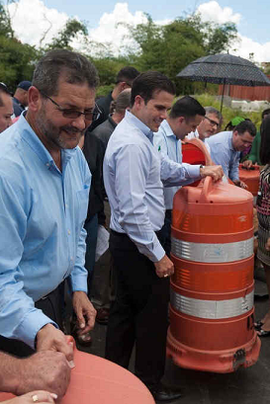
VIP Visits
VIP visits cause yet another convergence issue for incidents. Depending on who the visitors are and where they want to go, these visits can disrupt incident operations, cause additional traffic congestion, and attract a larger media presence.
On the other hand, such visits are valuable in providing VIPs with a realistic view of the problems posed by the disaster, and they may result in enhanced resources and provide a morale boost to responders and survivors. Most VIPs are aware of the impact their presence may have on operations, and are willing to coordinate visits with the incident management organization.

Slide 30
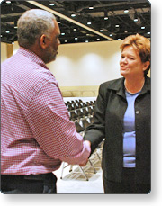
Strategies for Dealing With VIP Visits
Strategies for dealing with VIP visits include the following:
  When possible, encourage such visitors to wait until after the 72-hour window for successful rescues has passed.
  If visits must be scheduled before then, attempt to schedule visits to less time-sensitive operations.
  Identify appropriate background shots, photo opportunities, etc., before the visit.
  Confirm availability of key personnel (Public Information Officers, Incident Commanders, etc.) prior to the VIP’s arrival.
Try to limit time spent on scene. Conduct business away from the scene if possible.

Slide 31
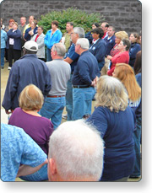
Unrequested Resources
During incidents, responders sometimes come to an incident area without being requested. Such personnel converging on a site, commonly referred to as self-dispatching or self-deploying, may interfere with incident management and place an extra logistical and management burden on an already stressed Incident Command organization.
The use of unrequested resources is highly discouraged. If your incident assigns a resource outside of the normal activation and request process, it is possible that your agency or jurisdiction may become liable for their actions, or for any accidents or injuries they incur while working. Your agency or jurisdiction may also be responsible for any expenses or reimbursement.
Although these resources may be trained and capable, the risks associated with assigning unrequested resources outweigh the advantages.

Slide 32

Strategies for Dealing With Unrequested Resources (1 of 2)
If unrequested resources must be used, consider the following strategies:
  Unrequested resources may become freelancers if the incident organization cannot organize to use them. Instruct perimeter personnel to refer unrequested emergency resources to staging or mobilization points. Staging Area Managers and Resource Unit Check-In Recorders must be ready to inventory resources for skills and readiness, check them in, organize them into appropriate tactical configurations and assign them to the incident. If their skills are not needed, they should return to normal status to avoid unnecessary impact on overall public safety coverage.
  An unrequested resource that has been accepted and assigned to the incident must be included in the resource tracking and incident planning process.

Slide 33
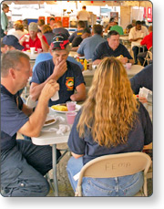
Strategies for Dealing With Unrequested Resources (2 of 2)
Additional strategies for using self-dispatched resources include:
  Information about the resource should be shared with the rest of the Command and General Staff, especially the Liaison Officer, and the Planning, Logistics, and Finance/Administration Section Chiefs.
  Nongovernmental and private-sector resources should be inspected and formal agreements completed as soon as possible.
  The presence and status of public-sector resources on the incident should be reported to their home agency.

Slide 34
Unit Summary
Planning and organizing to provide management and logistical support to complex incidents requires a level of detail well beyond "normal" incident response. Effective preparedness actions are required to:
  Organize, support, and integrate large quantities of resources from local, tribal, regional, State, and Federal sources.
  Anticipate and manage convergence issues resulting from unrequested resources, unsolicited donations, and unaffiliated volunteerism.
  Ensure scene safety.
The next lesson is the Course Summary.

